Slide 1

AW Invoice Process
Prepared by Claire Rollinson, September 2013

Slide 2
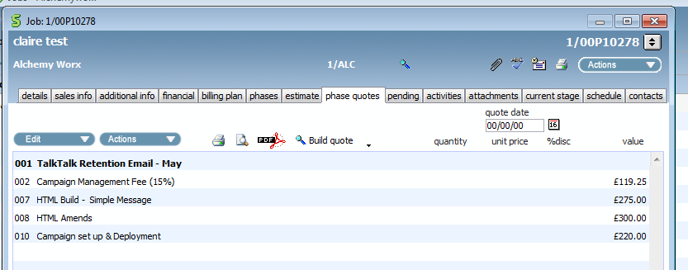
Creating a Draft invoice
Once job is fully complete raise draft invoice
Before competing invoice, check all costs have been assigned to phase quote – especially amends and the correct CM fee!
The CM fee will need to be added manually if any costs have changed
Ensure job name is listed as a sub header at top
‘Delete’ any spare lines not required
htgghht

Slide 3
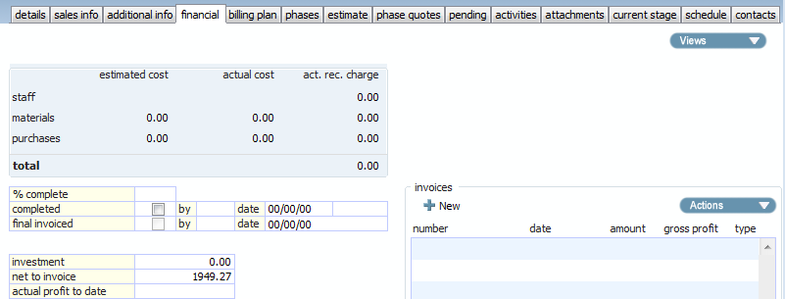
Creating a Draft invoice 1
Once job complete raise draft invoice
See page 40 of User guide
Navigate to the ‘financial’ tab on the job
Select ‘new’

Slide 4
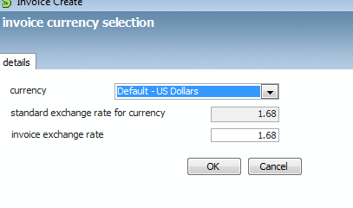
Creating a Draft invoice 1 a
For US and Euro invoices
Ensure the ‘invoice exchange rate’ is the same as the rate in the ‘standard exchange rate for currency’ field

Slide 5
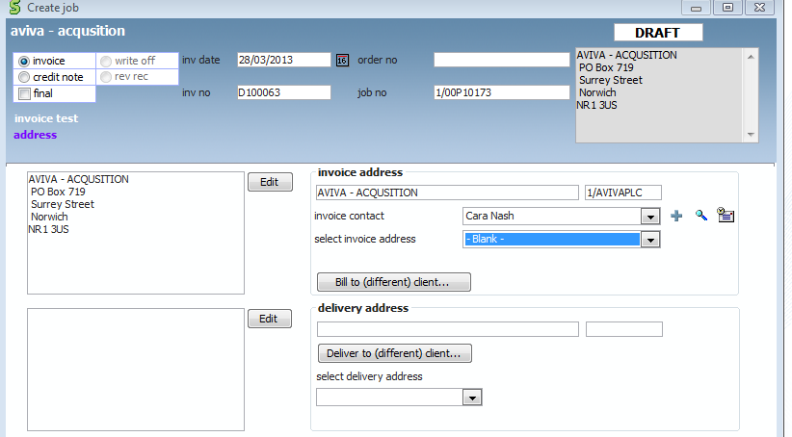
Creating a Draft invoice 2
Address details and PO number
If the invoice or delivery address is different to the company address select it here
Add the PO number to the ‘order no’ field on the top right if not already added
Select ‘next’ and move onto next screen

Slide 6
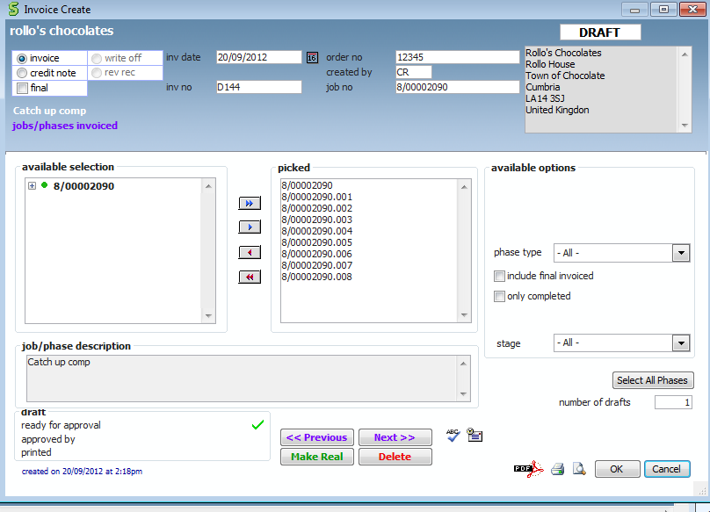
Draft invoice - 3
All phases of job are invoiced as default. If you are only invoicing for one phase of job select it here
Select ‘next’

Slide 7
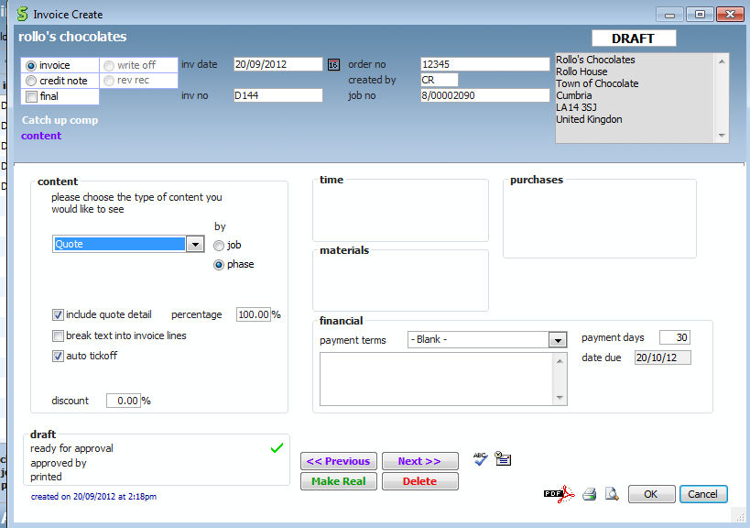
Draft invoice - 4
Select to show all content by ‘phase’ and ‘quote’
And select ‘next’

Slide 8
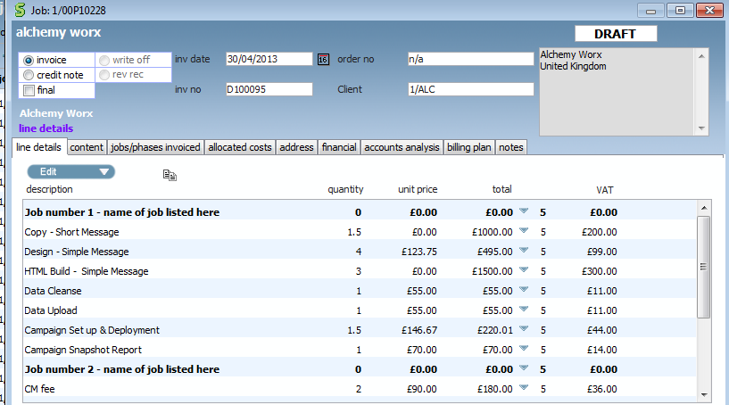
Draft invoice - 5
Click on ‘next’

Slide 9
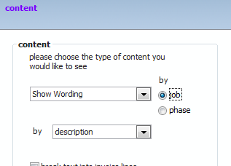
Draft invoice – 5b
If you need to amend the details on the invoice description. For example to state ‘ Email marketing services jan’ then go back to previous screen and amend ‘quote’ to ‘show wording’ and select ‘job’

Slide 10
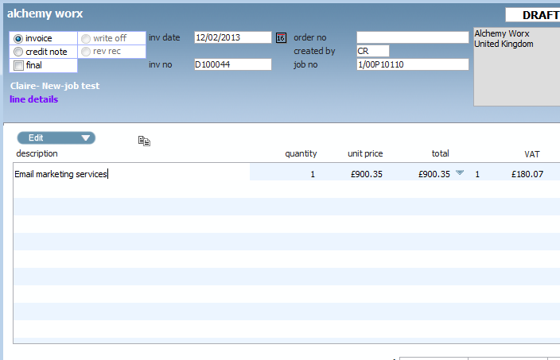
Draft invoice – 5c
Now go to ‘edit mode’ and amend the line details of what you want to appear on the invoice (as below)

Slide 11
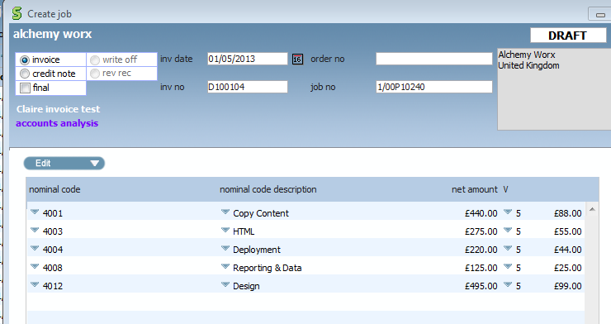
Draft invoice - 6
On ‘accounts analysis’ tab click on ‘edit’ and select ‘Auto analysis builder’ to pull through the nominal code and values. The total for ‘invoice analysis’ should match with ‘invoice total’

Slide 12
Draft invoice - 7
Click on ‘finish’
Click on the green tick ‘ready for approval’
The draft invoice is now ready for approval
You can now exit invoice screen and press ‘ok’
Claire R/John will ‘approve’ all invoices every morning
Invoice will remain as draft until it is ‘made real’ by finance team who in turn will review all draft invoices every day
Please note: As the draft invoice number becomes the real invoice number, please don’t delete draft invoices. Please just amend the invoice created before resubmitting for approval

Slide 13
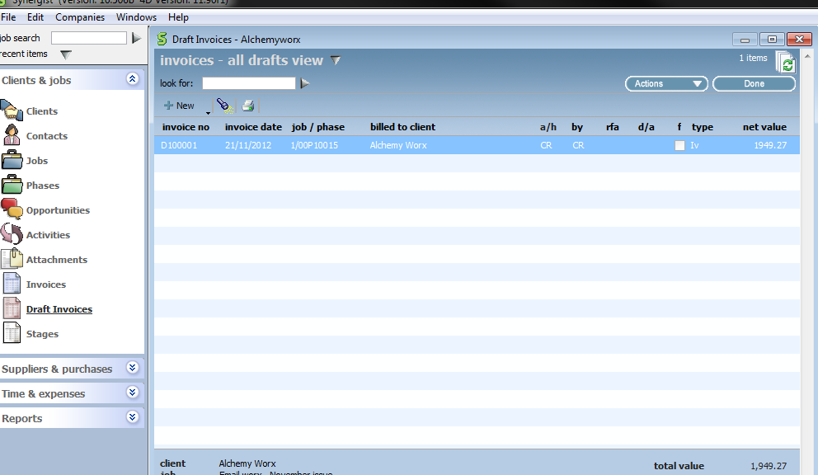
Draft invoice - 8
For approvers (Claire R /John)
On a daily basis navigate to the ‘draft invoices’ screen on the menu bar

Slide 14
Draft invoice - 9
Double click on the invoice you want to approve

Slide 15
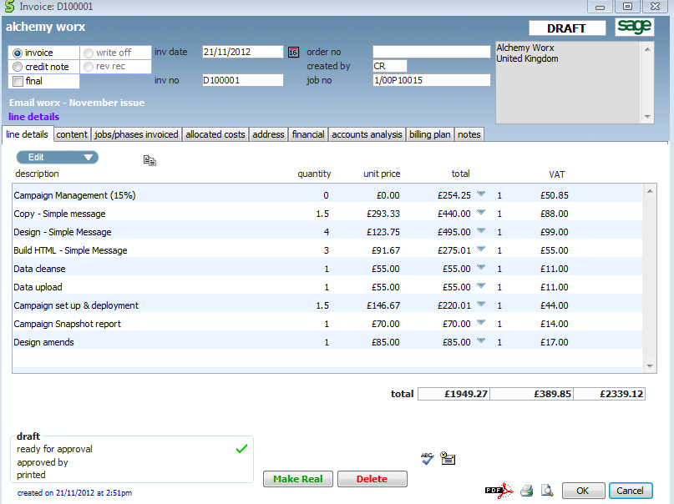
Draft invoice - 10
Check the invoice totals.
Check the CM fee is correct
Check all phases and stages have been invoiced for
If you are happy with invoice click on ‘approved by’
The invoice is now ready to be processed by finance

Slide 16
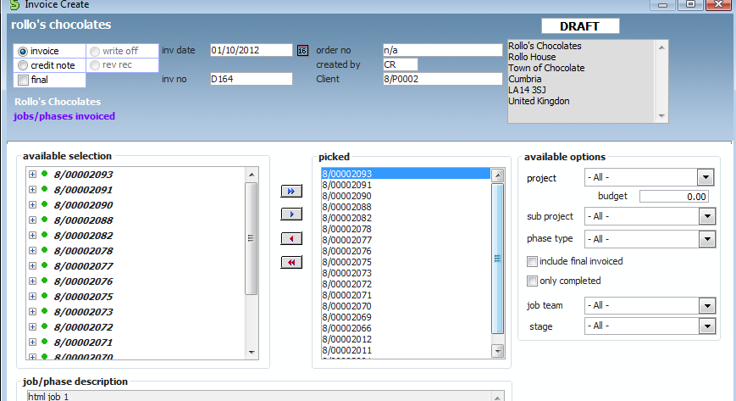
Creating an invoice with multiple jobs
Click on ‘+ New’ ‘Multi -job or phase invoice
Follow the same process as if you were creating a single job invoice
Select all the jobs you want to add to the invoice. (Note the descriptions are at the bottom)

Slide 17
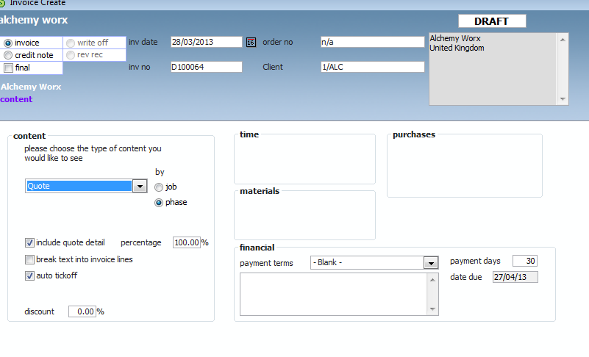
Creating an invoice with multiple jobs - 2
Select ‘quote’ by phase as is the default

Slide 18
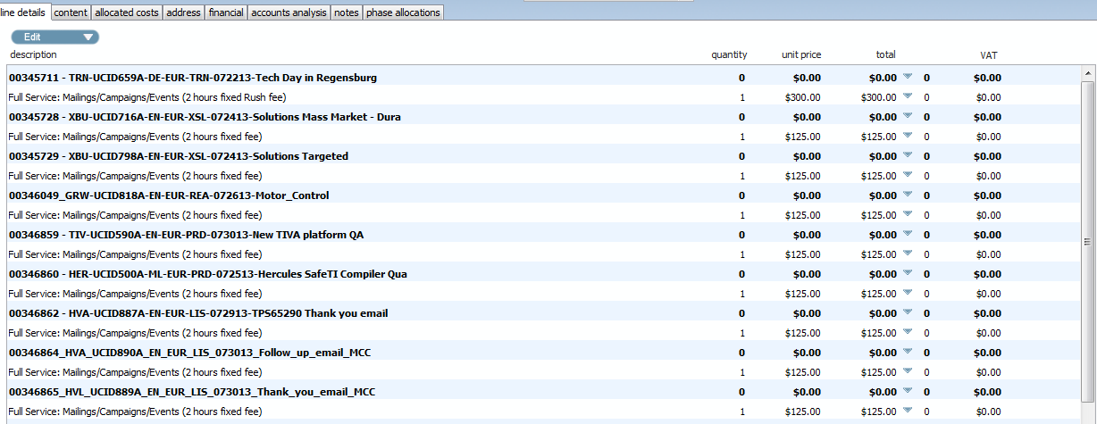
Creating an invoice with multiple jobs - 3
Check all jobs are listed are named correctly
Check all CM lines have values and are correct

Slide 19
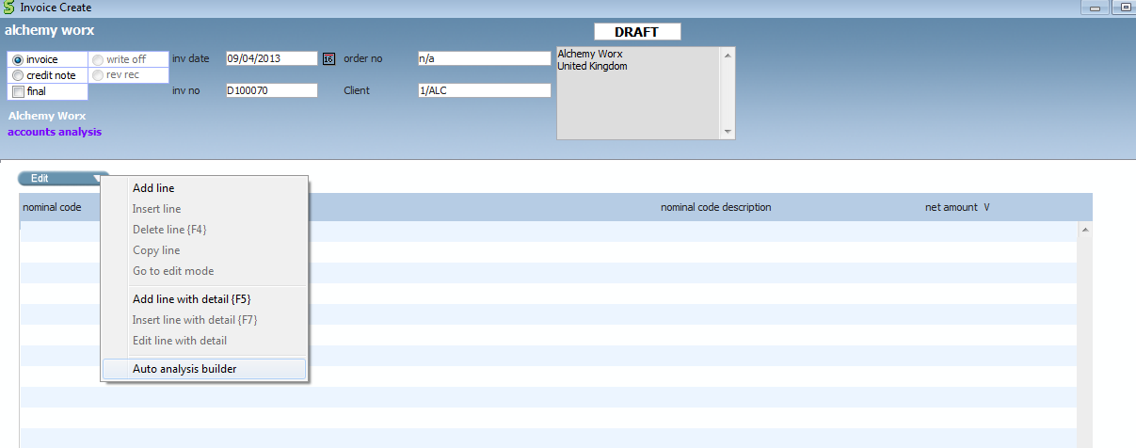
Creating an invoice with multiple jobs - 4
Select ‘edit’ and then ‘auto analysis builder’

Slide 20
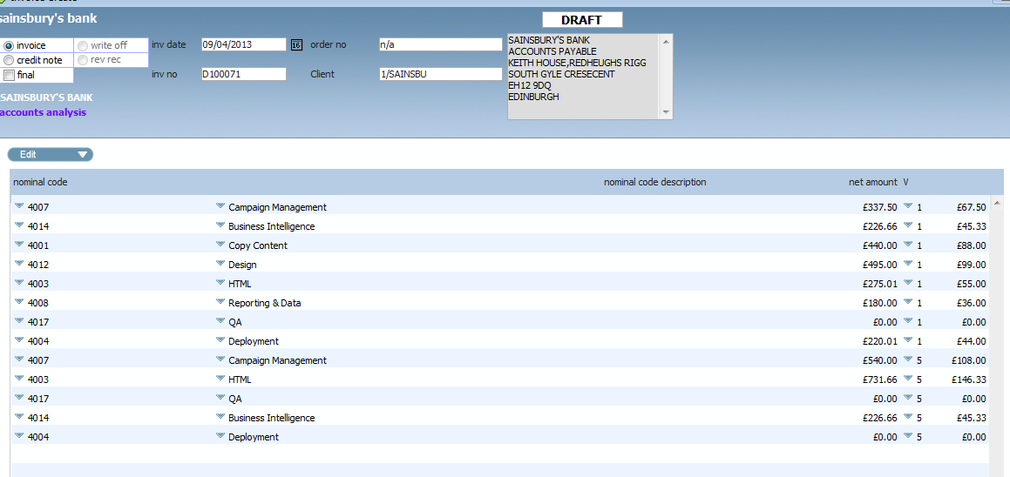
Creating an invoice with multiple jobs - 5
Check all items have a nominal code listed

Slide 21
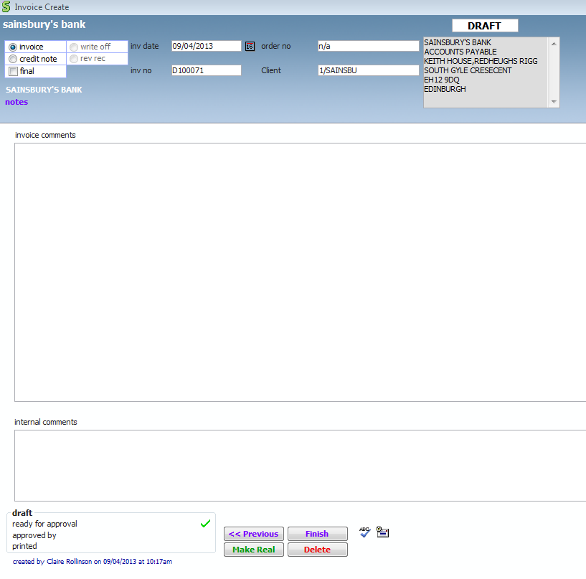
Creating an invoice with multiple jobs - 6
If you are happy then click ‘finish’
Again click on the green tick to shown invoice is ready for approval
Invoice is now ready for approval by a senior campaign manager

Slide 22
PO’s
If the invoice does not require a PO please input ‘N/A’ in the order no field
If the invoice is missing the PO number keep chasing client by phone until we receive the PO. The invoice and therefore the project is not complete until this has been added ( the invoice cannot be sent to the client until we have PO)
If you add a PO to an invoice after it has ‘made real’ by finance. (i.e no longer a draft as indicated by ‘d’100878) then please add PO number as usual and then email Georgia/Charlotte to indicate PO has been added and invoice can now be sent to client
When you receive the ‘missing PO List’ report from Georgia you should be going through this and checking all invoices for your clients.

